Slide 1
CT3112: Professional Skills – Ethics component
Lecturer: Dr Orla Richardson
U. of G. Discipline of Philosophy
Week 9: Lecture 2 – General Issues in Engineering Ethics
Video 1: Recap & Ethical decision-making
Duration:
Email: Orla.Richardson@universityofgalway.ie

Slide 2
Outline:
Week 9 Videos:
Professional Obligations and Responsibilities
Safety (workplace & public)
[conflict of interests, the role of engineers in relation to managers,
the role of engineers as managers, issues around confidentiality
and loyalty, whistle-blowing]

Slide 3
Ethics Component: Overview
Assessment
Online Ethics MCQ
25 questions
Worth 25 points
MCQ release date: 15/03/24
MCQ close date: 22/03/24

Slide 4
Last Time
Normative Theories
Applied Ethics – Professional Ethics - Engineering Ethics
Resources for ethical decision-making beyond NT:
Ethical principles
&
Professional codes
Options: Focus on your character (virtue ethics), focus on
outcomes (consequentialism), focus on moral laws(deontology)
Focus on ethical issue that arise at work
Focus on practical problems
Moral concerns and decisions that
are specific to engineering practice
Try to do Good. Minimise harm. Be just.
Have integrity. Respect others.
Codes of conduct created by professional associations

Slide 5
Reminder: What is the code for?
A code’s function is to:
inspire technical and moral excellence
2) educate new members,
3) inform non-members about appropriate expectations,
4) set standards,
5) support professionals in decision-making
- when you are faced with a difficult moral decision refer to the code
- when you recognise that a colleague is acting inappropriately refer to the code

Slide 6
Support the code!
Engineers should not only know the profession's code but support
it by encouraging compliance and by criticizing those who fail to
uphold it.
Why support the code?
protects employees/professional and the general public
from the negative consequences of morally problematic practice
helps create a working environment were pressure to
compromise professional integrity is easier to resist
means doing your part in generating benefits (respect etc.,) for
all engineers.

Slide 7

Reminder of our primary method
Case Studies
Case studies are a highly successful means of demonstrating
the ethical problems that could be experienced in professional
work environments.
Reflection on realistic cases
Helps develops ethical decision-making skills by putting you
in the situation and asking you to decide what should be done.

Slide 8

Ethical Decision-making model:
1. Evaluate all the information you have
2. Consider how your decision might affect all of the relevant stakeholders.
3. Consider what ethical principles and/or professional codes matter for the
situation. [Consider also the legal implications of your actions.]
4. Determine the best course of action that reflects your values and the
stakeholders’ interests.
5. Be prepared to change your mind or admit error (if new information
emerges or mistakes are made)
6. Continue to reflection on decision-making in preparation for next time

Slide 9

Reflecting on Ethical Decision making:
Case Study 6: Testing a product
Question: Should you be
prepared to professionally
guarantee a product when there
is still one ‘test’ left to run?
Ask:
What ethical principles matter here?
Could you be violating a professional code of conduct?
If there is a compromise (of ethical principle/code) at play
here, can it be justified?

Slide 10

Reflecting on Ethical Decision making:
Case Study 7: Information Request
Think:
Your legal obligations may not have the
same scope as your ethical obligations,
is doing the right thing just about legal
accountability?
Ask:
What ethical principles matter here?
Could you be violating a professional code of conduct?
Can you justify destroying the records?

Slide 11
CT3112: Professional Skills – Ethics component
Lecturer: Dr Orla Richardson
U. of G. Discipline of Philosophy
Week 9: Lecture 2 – General Issues in Engineering Ethics
Video 2: Safety – Society and Workplace
Duration:
Email: Orla.Richardson@universityofgalway.ie

Slide 12

Why does ethical decision-making matter?
Engineers must be primed to always consider the
impact of engineering activity because engineering
professionals are in service to society.
Let’s look at the code
Notes:
Engineers Ireland: Code of Ethics 2023. Pages 1-2.

Slide 13
Code of Ethics – basic tenets:
‘Members must act at all times with fairness, courtesy and good
faith toward all persons with whom the member has professional
dealings, and in accordance with the public good. A member’s
obligations to the client can never override their responsibility to
the public good, and members of Engineers Ireland should not
enter undertakings which compromise this responsibility. Members
must uphold the values of truth, honesty, and trustworthiness and
safeguard human life and welfare, and the environment.’
In keeping with these basic tenets, members must:
Hold paramount the safety, health, and welfare of the public;
the protection of the environment: and the promotion of health and
safety in the workplace;
Notes:
Engineers Ireland: Code of Ethics 2023. Pages 1-2.

Slide 14
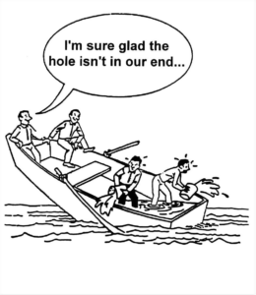
Moral Obligation:
Given your particular situation, circumstance, or role you are
required to act in specific ways – certain things must or must not be
done for moral, legal, or institutional reasons.
Moral Responsibility:
Given your particular situation, circumstance, or role you are held
accountable for achieving (maintaining) certain outcomes
Reflection:
Engineers and society
A kind of implicit social contract exists between engineers and society.

Slide 15
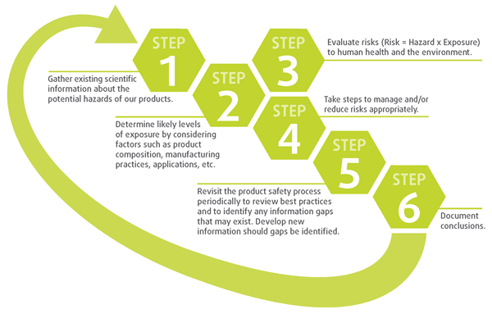
Safety – Product/Design/Application
One of the primary duties of engineers is to ensure that products
or services are designed with the safety of the public in mind.
Principle: Do
no harm

Slide 16
Criteria that ensures a safe design:
1. “the minimum requirement is that a design must comply
with the applicable laws.”
2. “an acceptable design must meet the standard of accepted
engineering practice.”
3. “alternative designs that are potentially safer must be
explored.”
4. “the engineer must attempt to foresee potential misuses of
the product by the consumer and must design to avoid these
problems.”
(Fleddermann, Engineering Ethics, p.65)

Slide 17
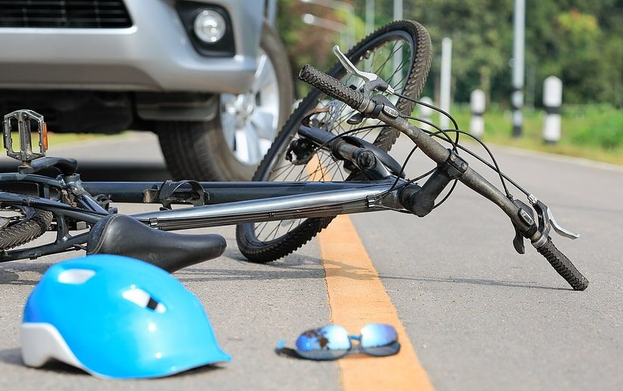
A safe design:
When engineers, managers, corporate owners, contractors,
subcontractors and inspectors demand high levels of safety the
entire engineering profession benefits. (Do Good)
Product liability Law
Liability For Defective Products Act, 1991
2.—(1) The producer shall be liable in damages in tort for damage caused wholly or partly by a defect in his product.
https://www.irishstatutebook.ie/eli/1991/act/28/enacted/en/print#sec2
PLL: body of legal rules that govern lawsuits for losses or injuries caused by defective products. Not caveat emptor but caveat venditor!

Slide 18
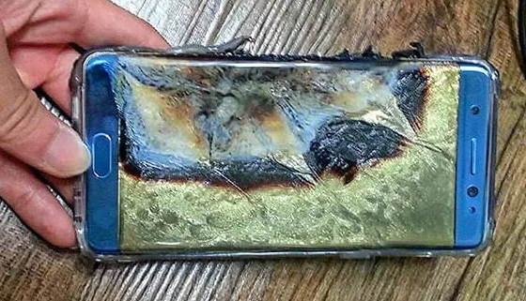
A safe design: Product liability Law
Intersection between, engineering, law and ethics
Reflect: Product failure
Engineers must be properly educated in product liability law and the legal concept of an "unreasonably dangerous product,“.
Engineers need to see the ‘big picture’ – be aware of what legal and ethical responsibilities they have for product safety even as a product progresses down the production chain.
- Establishing your legal responsibility — easy?
- Establishing your ethical responsibility – harder?

Slide 19
Workplace safety
Obligated to ensure that all employees have appropriate training
Safety issues emerge when:
there is a lack of training and lack of supervision
there is more emphasis on productivity/profit than the safety of
workers.
failure by employees to adhere to safety codes laid down by
the company or to report failures or abuses of safety codes to the
company or relevant authorities.
Case study 8: One solution – greater ‘worker’ engagement (at all levels) in health and safety issues and clear lines of communication between employees, engineers and management. See Health and Safety Executive (GB) case study Heathrow
Terminal 5 project. Link is on-line.

Slide 20
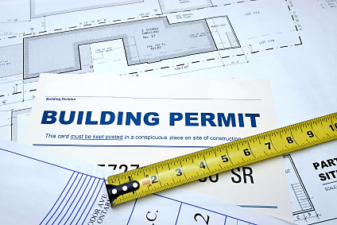
Reflecting on Safety: Code Enforcement
Case Study 9: Code Enforcement
Ethical trade-off:
Is righting a wrong with
another wrong ever acceptable?
Are you a deontology or consequentialist?

Slide 21
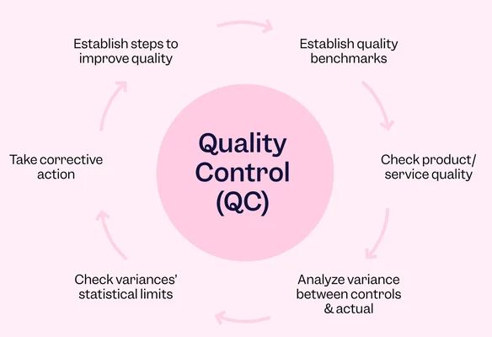
Reflecting on Safety: Quality Control
Case Study 10:
Quality control
Should the line engineer
stand by and let defective
products ‘go out
the door’?
Is this case study really about the potential for ethical tensions to
exist between managers and engineers?

Slide 22
CT3112: Professional Skills – Ethics component
Lecturer: Dr Orla Richardson
U. of G. Discipline of Philosophy
Week 9: Lecture 2 – General Issues in Engineering Ethics
Video 3: Engineers and Managers
Duration:
Email: Orla.Richardson@universityofgalway.ie

Slide 23
Engineering Management aims: to create and maintain an
environment in which individuals working together in groups
successfully accomplish organisational or institutional
objectives
Role:
Managers focus on issues of efficiency and productivity
Managers have obligations to the organisation/institution
Managers often perceive themselves as having a special
duty to protect the financial well-being of those organisations
or institutions

Slide 24
Engineers have an obligation to protect the public.
An engineer might have to prioritise social responsibility
(public good) over loyalty to ‘the company’.
This potential conflict may even become more pronounced
when engineers are placed in management roles.
Interpersonal conflict – you and your manager, you and more senior representatives of your company or institution
The individual plays a dual role, and if there is an ethical conflict it will be internal, a conflict that plays out in virtue of the roles you play

Slide 25
Dual roles:
In some professions, ‘dual roles’ can be ethically problematic
In Psychiatric Ethics, for example, ‘dual roles’ are established
when a relationship that includes non-patient focused interests
(e.g. contractual, social, sexual, or financial) exists and may
interfere with beneficial treatment for the patient
Examples:
Military psychiatrists and
combat-readiness
Forensic psychiatrists and
public safety
Might be in individual’s best interests to be relieved of duty but not in the best interests of the military
Rehabilitation vs.
recidivism risk

Slide 26
Engineers as managers - Dual Role?
Often a manager, even if she has engineering experience, is
not as up to date on current engineering practices as practicing
engineers.
It is important that managers do not ignore their own
engineering experience, or the expertise of their subordinate
engineers.
A difficult ‘ethical balancing act’ might be required.

Slide 27
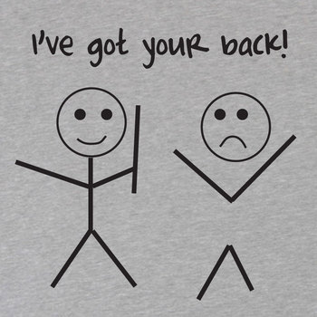
Reflecting on Loyalty:
Case Study 11: Loyalty
What do you think loyalty requires?
Do you think that whatever a
company (that you
work for) wants to do with its
products or whatever links it wants
to form with other relevant
stakeholders is simply not
your business?

Slide 28
Documented cases of the disregard for ethical codes in engineering practice
Many major disasters, due to failure in design or negligence on the part of engineers or management have resulted in the loss of many human lives.
The space shuttle Challenger disaster in 1986, which resulted in 7 deaths.
The Kansas City Hyatt-Regency Walkway accident (1981) which caused the deaths of 114 people and 185 injured.
Gulf Oil Spill: Deepwater Horizon Disaster 2010. 11 killed and 75 injured.

Slide 29
Reflecting on the space shuttle Challenger disaster (1986)
Case Study 12: Challenger
Safety is the paramount consideration. The engineers could
not say the launch would be safe. The launch should have been delayed.
But engineering supervisor Robert Lund told to “Take off your
engineering hat and put on your management hat.”
Conflict of obligations: profit/politics/reputation before safety
Attempted cover-up (by Morton Thiokol), Robert Boisjoly
refuses to let this happen (considered to be a whistleblower) but
at great personal and professional cost

Slide 30
CT3112: Professional Skills – Ethics component
Lecturer: Dr Orla Richardson
U. of G. Discipline of Philosophy
Week 9: Lecture 2 – General Issues in Engineering Ethics
Video 4: Whistle-blowing
Duration:
Email: Orla.Richardson@universityofgalway.ie

Slide 31
Few topics in Engineering Ethics are as controversial as whistle-blowing.
Definition:
‘The disclosure by organization members (former or current) of
illegal, immoral and illegitimate practices under the control of their
employers to parties and organizations that may be able to effect
action’. (Miceli & Near, 1985 525)
The term intends to be evocative - a shrill sharp sound, giving a warning of harm or call a halt to actions

Slide 32
Whistleblowing:
Very often the term is reserved for actions of disclosure that step
outside of approved organizational channels to force attention to a
significant moral issue.
However, some definitions of Whistleblowing consider raising
concerns
- to the ‘wrongdoer’,
- to other colleagues,
- to supervisors/local managers as a form of internal whistle-blowing

Slide 33
More often we think of Whistleblowing as drawing public
attention (rather than private or inner-institutional attention) to
specific actions/practices that jeopardise public safety – illegal,
immoral or illegitimate.
Whistleblowing: is alerting relevant persons to some moral or
legal corruption where ‘relevant persons’ are those in a position
to act in response.
Governmental agencies or authorities.
Professional organisations.
If inaction here, forced to go public.

Slide 34
Step 1: Is there a situation that could potential turn into a whistle-blowing incident?
Step 2: Seriousness test.
Assess – is something illegal, immoral and/or illegitimate happening?
Assess – is there a serious threat to public safety?
Step 3: Report to immediate manager/supervisor
Step 4: Report to upper management - senior managers, board of
directors, owners.
Step 5: Going outside the organisation - going outside the organisation
usually means reporting concerns (with appropriate evidence trail) to
governmental authorities and, if necessary, going public.
Whistle-blowing: The Basic Steps

Slide 35
Step 6: Living with the consequences - As a whistle-blower you must
also be prepared to face the consequences of your actions
Whistleblowing is often done for relevant and important moral
reasons but reactions to whistle-blowers can vary
Reactions:
Appreciation
Reactions of colleagues – perceived lack of trust or loyalty
Potential harm to reputation within the profession
Retaliation - loss of employment.
Whistle-blowing: The Basic Steps

Slide 36
Whistle-blowing: A basic ethical dilemma happens when:
An engineer’s duty (moral obligation) to ensure public health and
safety (to report unsafe work practices, designs, products, processes
but also, perhaps, abuses of power or gross mismanagements of
public funds or resources, and so on) clashes with an engineer’s
obligations to either a client and/or employer.
Whistleblowing is about reducing harm/doing good, promoting justice, integrity, and honesty | Whistleblowing is perceived as breaking confidentiality, appearing disloyal, and harming the reputation of the profession.

Slide 37
Whistle-blowing: Moral distress and Moral courage
Moral distress: You observe wrongdoing but feel unable
to act
- organisational constraints (workplace culture)
- personal constraints (fear of consequences)
Moral courage: recognise that morally a certain action is required
of you, understand the potential negative consequences, yet still
act in accordance with professional ethical code and personal
ethical values.
Question: Can moral courage be taught?
In the sense that it can be developed or strengthened by education and reflection?

Slide 38
The organisation and the whistleblower
A paradox for the organisation
Legally and morally an organisation is required to protect a
whistleblowing while the very actions of that whistleblower may
destabilise or harm that organisation.
See the opportunity, protect the whistleblower not the status quo
Whistle-blowers may harm the organization in the short term, but they offer the opportunity to reform organisational practices that may already be harming professionals and professional reputations, the customers or clients of your organisation.

Slide 39
Given the potential negative implications of whistle-blowing, it is important that legal protections exists
In Ireland there is the Protected Disclosures Bill 2014 as
amended by the Protected Disclosures (Amendment) Act 2022.
This statutory framework offers protection to workers who make a
protective disclosive from dismissal, penalisation or other
sanctions by their employers.
Free and independent supports are also available.
Anyone can contact the free and confidential ‘Speak Up’
Helpline (1800 844 866) or use the Secure Repot form, email, post
or signal app which is operated by Transparency International
Ireland.

Slide 40
Reflecting on Whistleblowing
Case Study 13: City Engineer
Has the engineer (Mario) in this case study made the right
set of decisions?
Has he done enough to fulfil his moral obligations?
Be sure to read the Review from the Board of Assessment

